Slide 1
The Power Rule and other
Rules for Differentiation

Slide 2
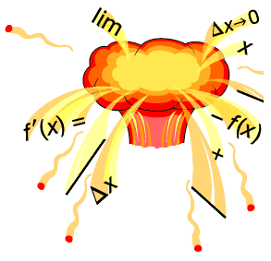
Rules for Differentiation
Taking the derivative by using the definition is a lot of work.
Perhaps there is an easy way to find the derivative.

Slide 3
Objective
To differentiate functions using the power rule, constant rule, constant multiple rule, and sum and difference rules.

Slide 4
The Derivative is …
Used to find the “slope” of a function at a point.
Used to find the “slope of the tangent line” to the graph of a function at a point.
Used to find the “instantaneous rate of change” of a function at a point.
Computed by finding the limit of the difference quotient as ∆x approaches 0. (Limit Definition)

Slide 5
Notations for the
Derivative of a Function
“f prime of x”
“y prime”
“the derivative of y with respect to x”
is a noun.
is a verb. “Take the derivative with respect to x…”

Slide 6
Rules for Differentiation
Differentiation is the process of computing the derivative of a function.
You may be asked to:
Differentiate.
Derive.
Find the derivative of…

Slide 7
Video Clip from
Calculus-Help.com
The Power Rule

Slide 8
Rules for Differentiation
Working with the definition of the derivative is important because it helps you really understand what the derivative means.

Slide 9

The Power Rule

Slide 10
The Constant Rule
The derivative of a constant function is zero.

Slide 11
The Constant Multiple Rule
The derivative of a constant times a function is equal to the constant times the derivative of the function.

Slide 12
The Sum and Difference Rules
The derivative of a sum is the sum of the derivatives.
The derivative of a difference is the difference of the derivatives.

Slide 13
Constant Rule
Find the derivative of:

Slide 14
Power Rule
Differentiate:

Slide 15
Constant Multiple Rule
Find the derivative of:

Slide 16
Constant Multiple Rule
Find the derivative of:

Slide 17
Constant Multiple Rule
Find the derivative of:

Slide 18
Rewriting Before Differentiating
Function | Rewrite | Differentiate | Simplify

Slide 19
Rewriting Before Differentiating
Function | Rewrite | Differentiate | Simplify

Slide 20
Rewriting Before Differentiating
Function | Rewrite | Differentiate | Simplify

Slide 21
Rewriting Before Differentiating
Function | Rewrite | Differentiate | Simplify

Slide 22
Sum & Difference Rules
Differentiate:

Slide 23
Conclusion
Notations for the derivative:
The derivative of a constant is zero.
To find the derivative of f (x) = x^{N}
  Pull a copy of the exponent out in front of the term.
  Subtract one from the exponent.

